Slide 1

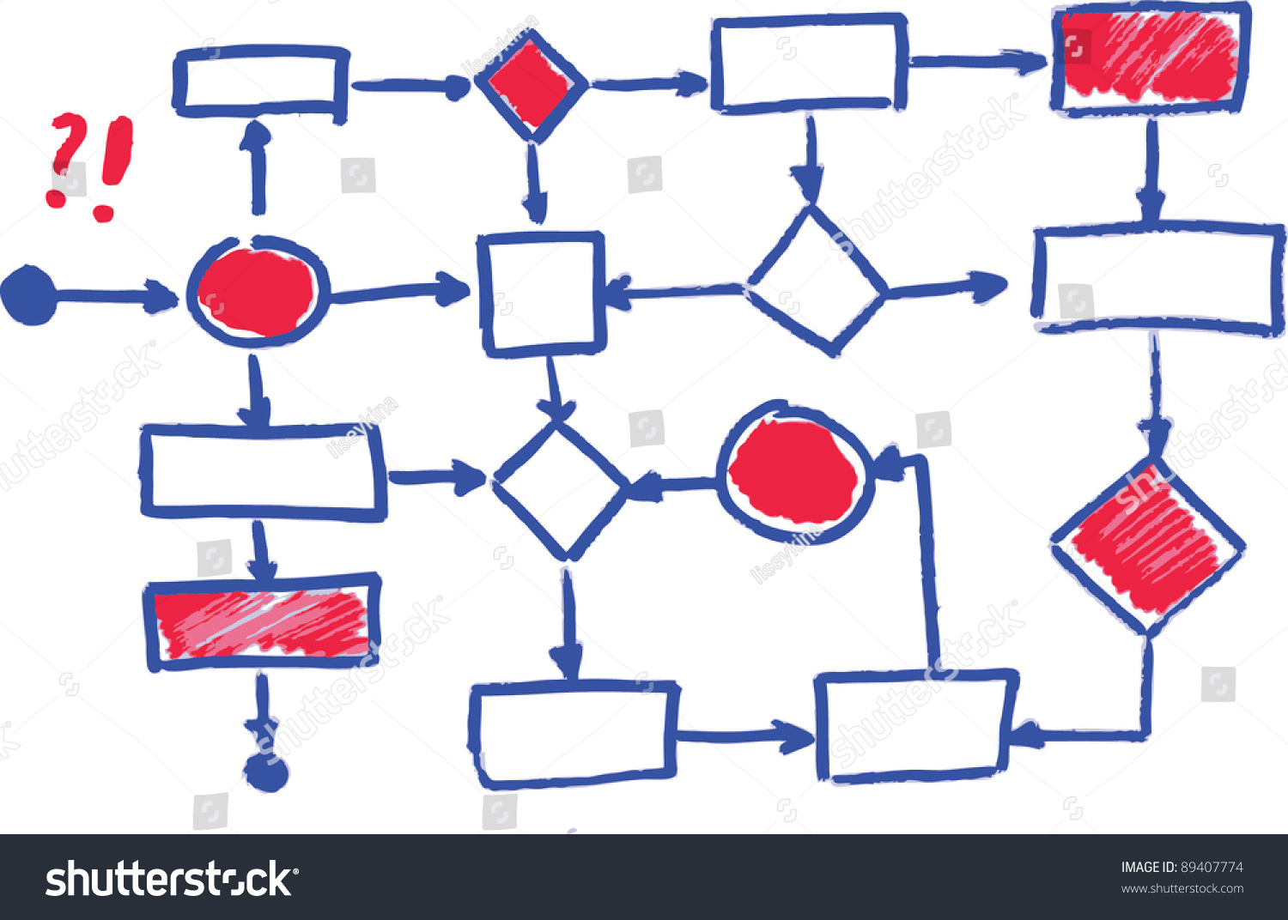
Enhanced Diagram Evaluation In Education System By Integrating Graph-Based Logic Analysis with LLM-Assisted Contextual Understanding

Slide 2
Abstract:
In automated grading systems for education, evaluating diagrams, such as flowcharts, often overlooks deeper aspects like logic and problem-solving. While Large Language Models (LLMs) provide contextual evaluation, they may miss logical consistency. This paper proposes an enhanced system combining graph-based analysis with LLM-assisted evaluation. By using graph traversal algorithms, we assess the logical flow and structural correctness of diagrams, while the LLM evaluates the semantic meaning of diagram text. This hybrid approach improves grading accuracy by addressing both structural and contextual aspects, ensuring better learning outcomes in academics.
Keywords:
Automated grading, education, diagram evaluation, graph-based analysis, LLMs, logical flow, structural correctness.

Slide 3
Introduction
Automated Grading : The use of technology for grading in academic subject is growing, particularly for diagram-heavy content like flowcharts.
Challenges with Current Approaches: Existing methods focus on structural and textual correctness but fail to fully assess the logic and problem-solving approaches in diagrams.
Role of LLMs: While LLMs provide contextual understanding, they often miss deeper logical relationships between diagram components.
Need for Enhanced Evaluation: A more comprehensive approach is needed to analyze not just text but also the logical flow and structure of diagrams.
Objective: This paper proposes a hybrid system combining graph-based analysis and LLM evaluation to improve the accuracy and depth of automated grading in education.

Slide 4
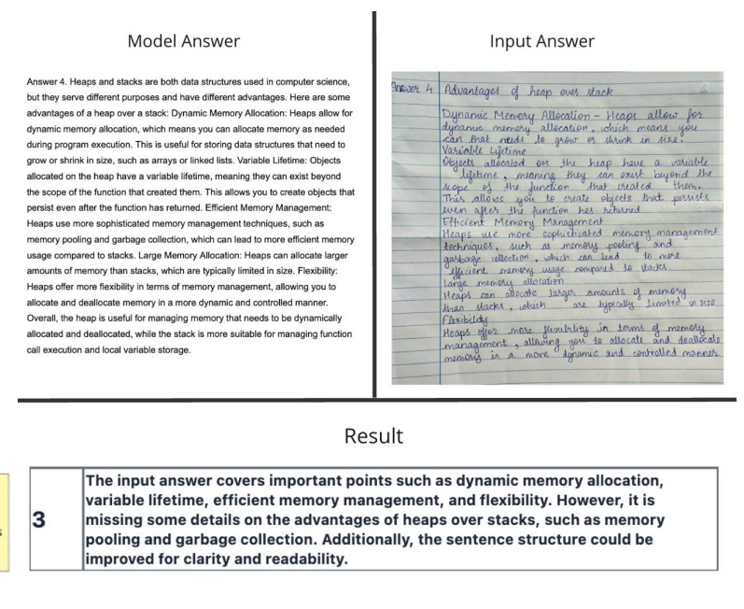

Slide 5
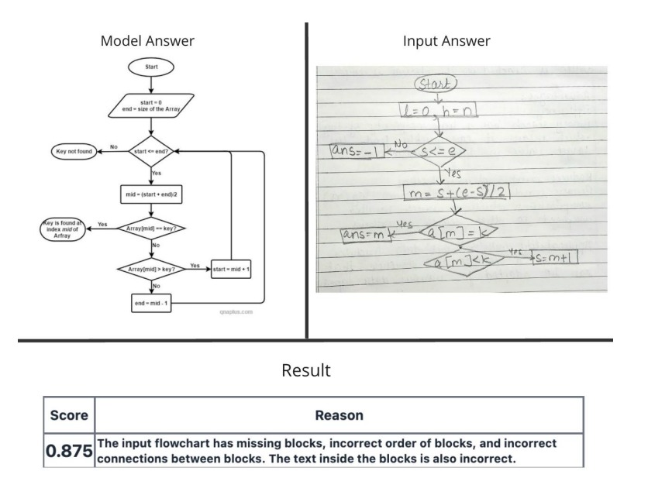

Slide 6
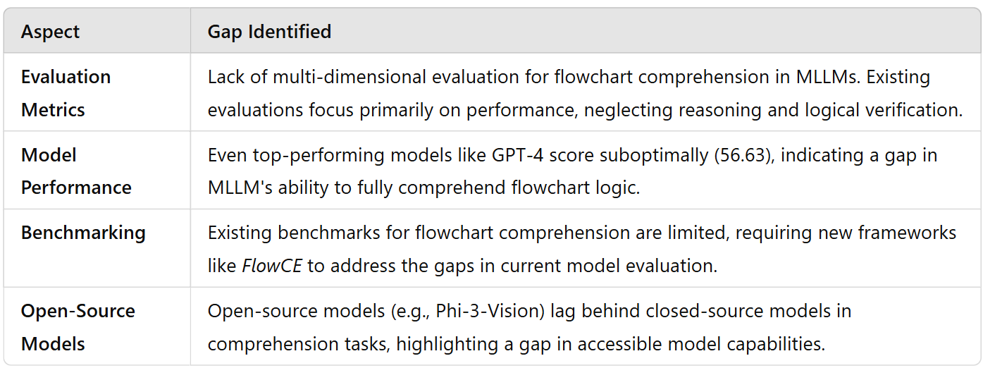
Real time tool

Slide 7
Literature Review
Paper Name | Year | Author(s) | Drawback/Research Gap
[2407.10793] GraphEval: A Knowledge-Graph Based LLM Hallucination Evaluation Framework | 2024 | Hannah Sansford, Nicholas Richardson, et al. | Limited to analysing hallucinations and focusing on hallucination correction. Lacks practical use of graph based corrections.
[2409.15749] Automated Assessment of Multimodal Answer Sheets in the STEM domain (arxiv.org) | 2024 | Rajlaxmi Patil, et al. | Limited to using LLMs for evaluating diagrams, which may miss logical relationships and flow consistency.
Recognition of Handwritten Flowcharts using Convolutional Neural Networks (ijcaonline.org) | 2022 | C. David Betancourt Montellano, et al. | Focuses on handwritten flowchart recognition but lacks advanced logical evaluation of flow consistency.
Online recognition of sketched arrow-connected diagrams | International Journal on Document Analysis and Recognition (IJDAR) (springer.com) | 2016 | Martin Bresler, Daniel Pruša, et al. | Only recognizes diagrams; does not incorporate a logical evaluation of the process or decision flows.

Slide 8
Aspect | Existing Methodology | Proposed Methodology
Logical Flow Evaluation | Evaluates diagrams mostly for textual correctness, missing subtle logical inconsistencies or improper decision branches. | Graph-Based Analysis ensures proper logical flow, detecting missing connections, inconsistent decision branches, and feedback loops for a deeper assessment of diagram logic.
Error Detection | Limited to identifying textual errors, often missing structural or logical flaws in the overall process of the diagram. | Provides advanced error detection, identifying specific logical mistakes such as incorrect flows, missing links, or incomplete processes, offering detailed feedback.
Comprehensive Grading | Focuses on structural correctness and text, but often misses evaluating the diagram’s problem-solving approach and logical integrity. | Combines graph traversal and LLM understanding to evaluate the structure, logic, and problem-solving approach, ensuring a more comprehensive and accurate assessment.

Slide 9
Market Research
Platforms like Coursera, edX, and Khan Academy use AI to grade and provide feedback on STEM-related assignments, including diagrammatic problems. However, these systems are often text-focused and lack advanced capabilities for logical or semantic diagram evaluation.
E-education platforms, their Generative AI chapter - The Hindu
Stanford has developed and tested AI models for automated grading as part of its AI and education research initiatives, emphasizing methods like OCR and semantic analysis.
Grade Like a Human: Rethinking Automated Assessment with Large Language Models | SCALE Initiative
AI Grading in Peer Reviews: Enhancing Coursera’s Learning Experience with Faster, High-Quality Feedback - Coursera Blog

Slide 10
Problem Statement:
Traditional grading methods in an education system require significant teacher effort to evaluate the structural correctness and logical integrity of diagrams like flowcharts. Existing automated systems fall short by focusing solely on textual evaluation, necessitating a hybrid approach combining graph-based analysis with LLM-based contextual evaluation for comprehensive and efficient assessments.

Slide 11
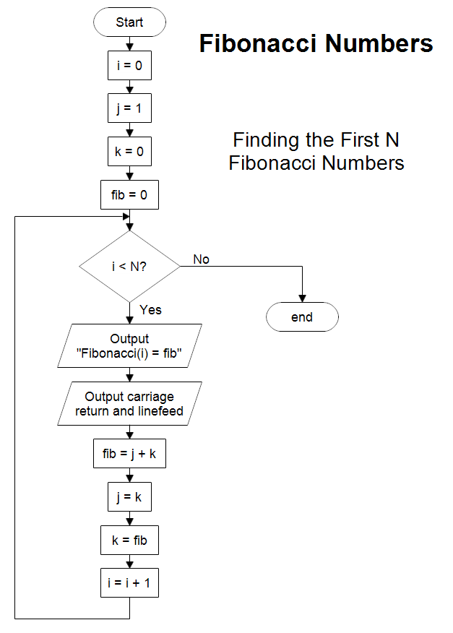
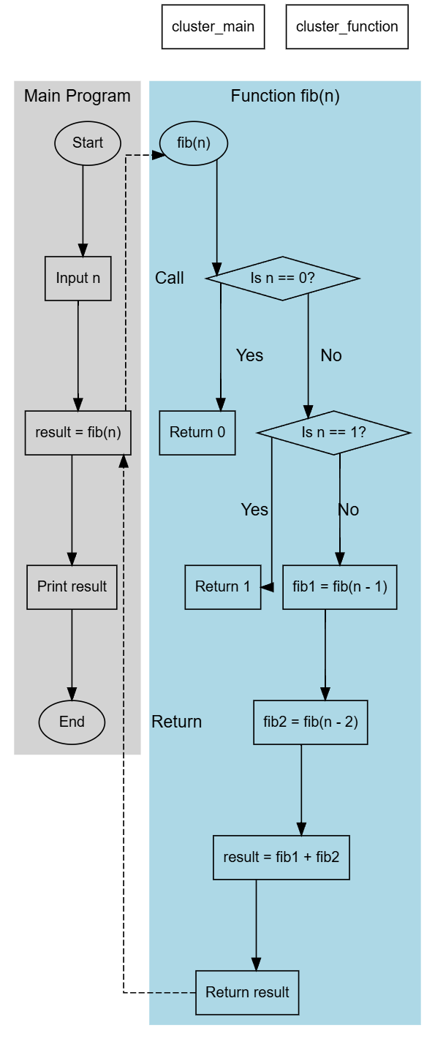
Same solution but different logical diagrams.

Slide 12
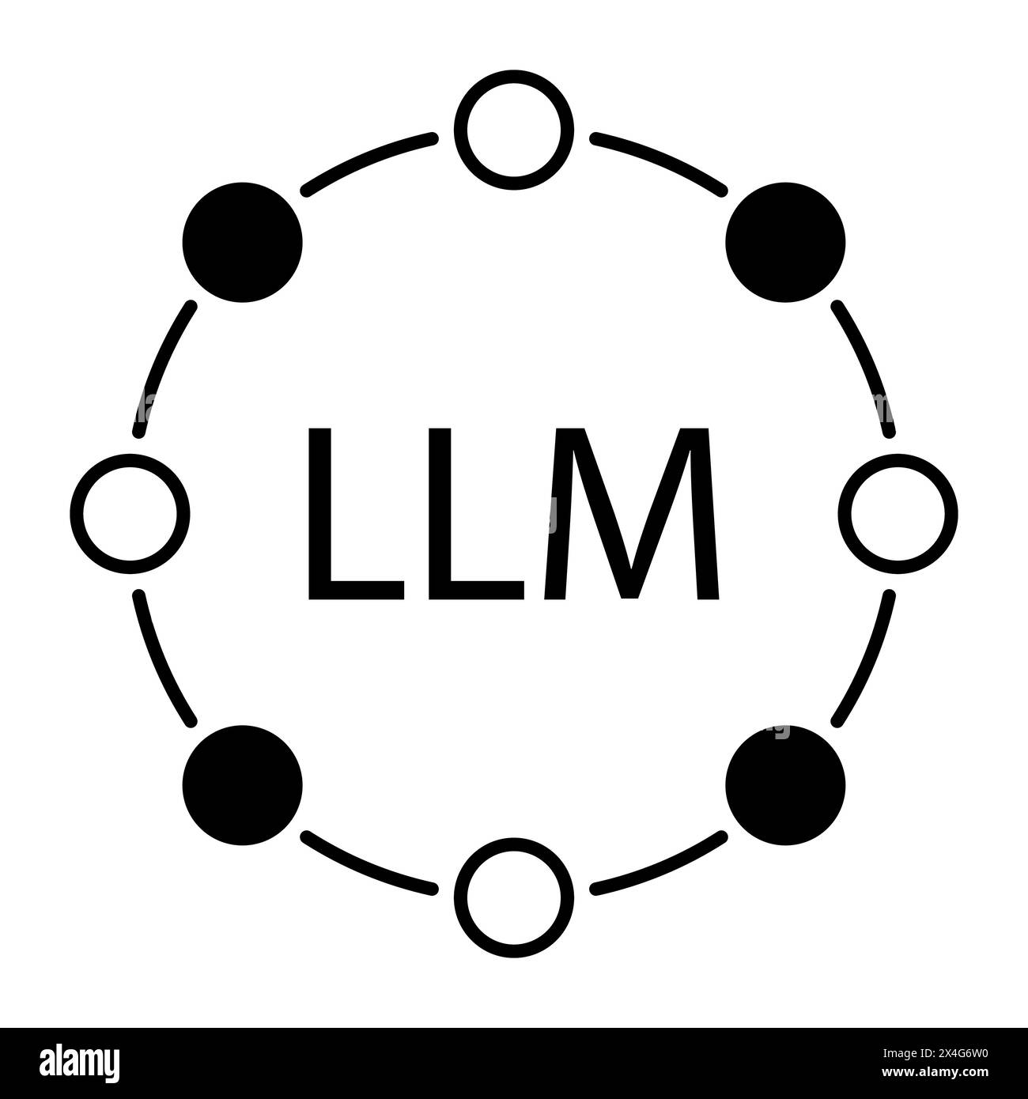
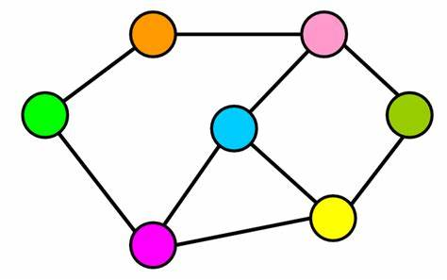

Proposed Solution:
To significantly enhance the evaluation of diagrams in education, we propose a hybrid evaluation system that integrates graph-based analysis with LLM-based contextual evaluation. This solution will focus on improving logical flow assessment, error detection, and overall grading accuracy.

Slide 13
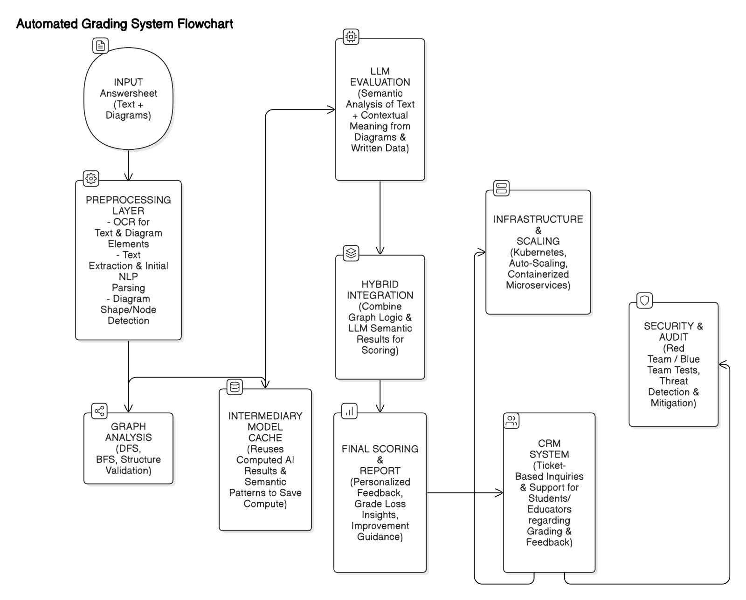
ARCHITECTURAL DIAGRAM

Slide 14
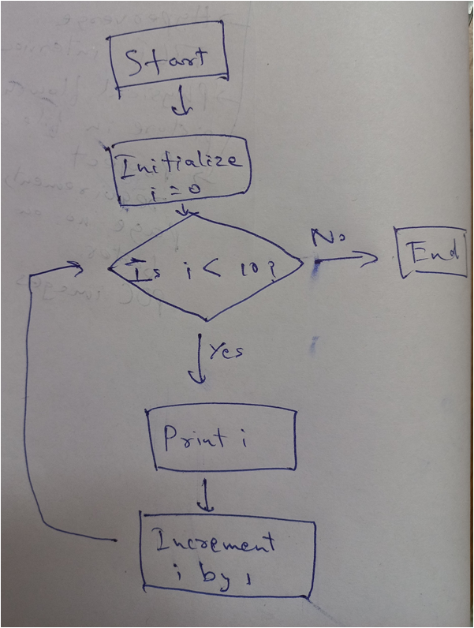
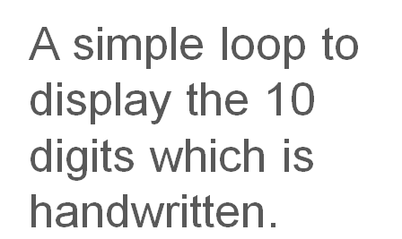
PROOF OF CONCEPT

Slide 15
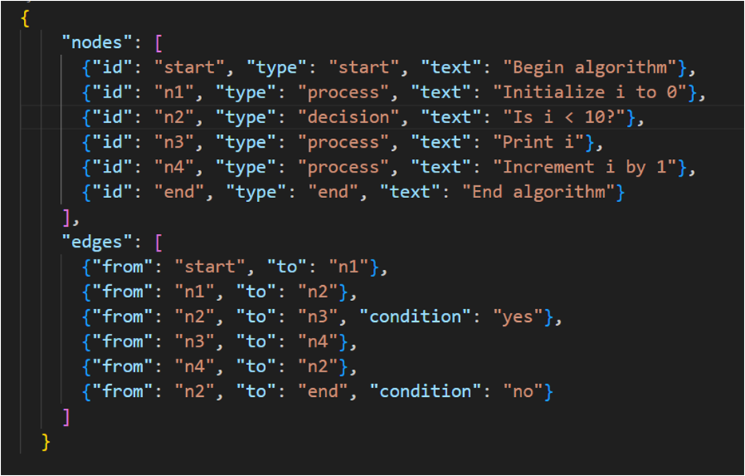
Handwritten data to json data format using OCR (Optical Character Recognition ) and Computer vision

Slide 16
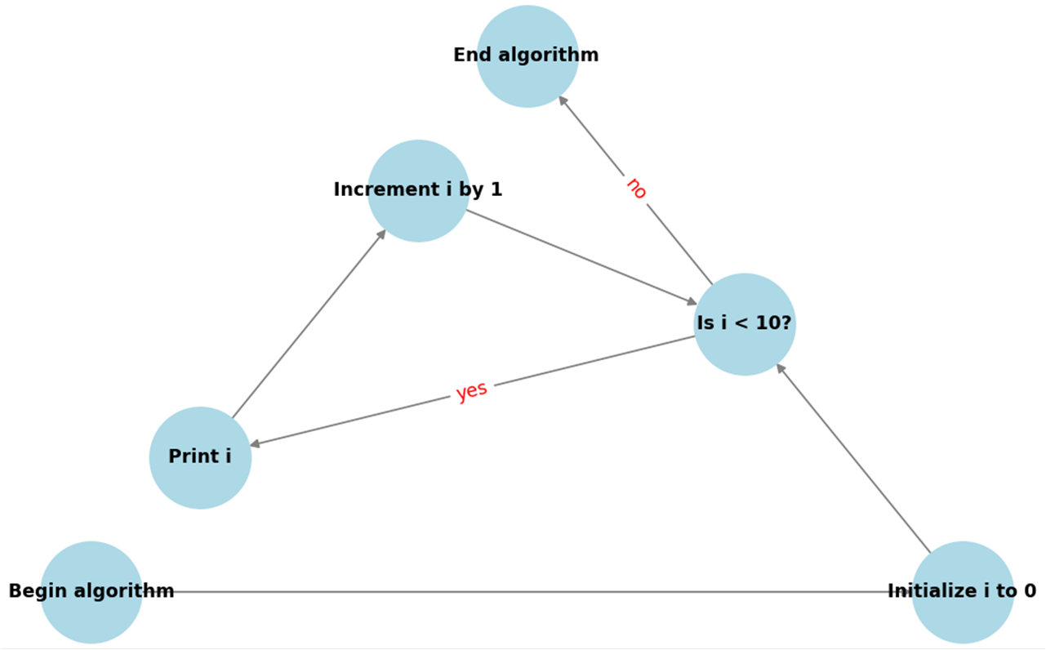
The json data file is converted into nodes and edges. It is currently unorganized.

Slide 17
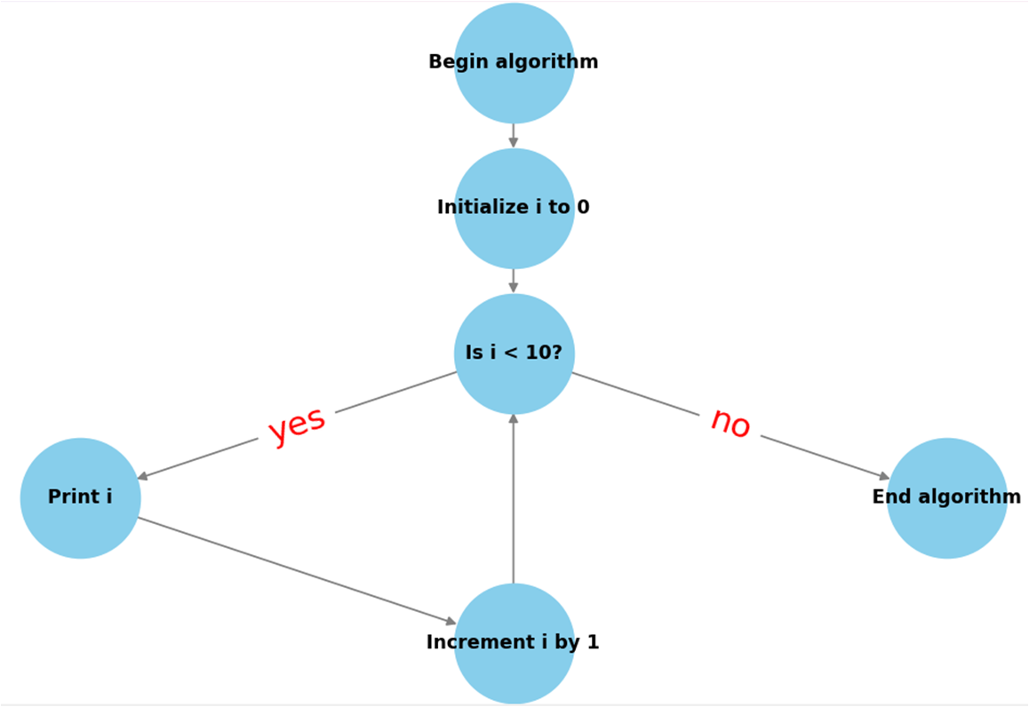
BFS is used to create hierarchy of the nodes and edges.

Slide 18
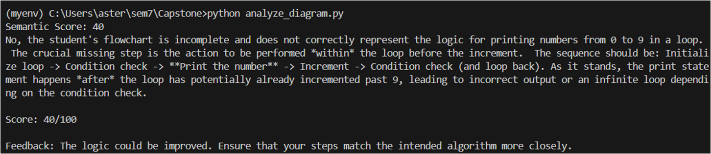
Diagram score is only 40/100 when using only LLM

Slide 19
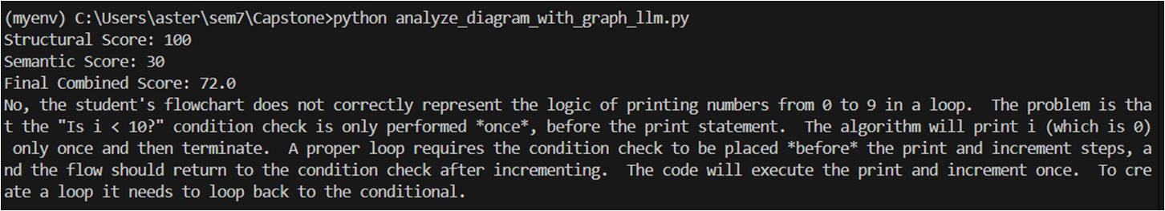
Diagram score is 72/100 when graph analysis verifies the structure.

Slide 20
Methodology:
Step | Method | Impact
Graph-Based Diagram Representation and Traversal | Convert diagrams into graph structures where nodes represent components and edges represent flow. Use graph traversal algorithms to check the logical flow and consistency. | Ensures full validation of the logical flow and identifies missing connections or incorrect branches, improving accuracy by 30-40%.
Error Detection and Structural Validation | Implement error detection to identify structural mistakes like missing branches, unconnected components, or faulty loops. Ensure logical completeness of all nodes and flows. | Improves detection of critical structural errors, enhancing grading accuracy for complex diagrams by 20-30%.
LLM-Based Contextual Understanding | Use LLMs to analyze the semantic content of text within diagram blocks, ensuring the text is contextually correct and aligned with the problem requirements. | Enhances the evaluation of textual content and contextual relevance, adding a 10-15% boost in semantic accuracy.

Slide 21
USE CASES
1.Business Process Automation: Automating workflows and decision-making processes using flowcharts, helping businesses improve efficiency.
2.Educational Tools: Assisting students in understanding complex concepts through interactive flowchart-based learning materials.
3.Software Development: Assisting developers in debugging, testing, and designing complex systems using flowcharts.
4.Healthcare Decision Support: Aiding doctors with medical flowcharts for diagnosing and recommending treatments.
5.Process Modeling: Streamlining industrial or engineering process modeling for optimization.

Slide 22
References:
Rajlaxmi Patil, Aditya Ashutosh Kulkarni, Ruturaj Ghatage, Sharvi Endait, Dr. Geetanjali Kale, Raviraj Joshi. "Automated Assessment of Multimodal Answer Sheets in STEM." arXiv preprint arXiv:2409.15749, 2024. Available: https://arxiv.org/abs/2409.15749
C. David Betancourt Montellano, C. Onder Francisco Campos Garcia, Roberto Oswaldo Cruz Leija. "Recognition of Handwritten Flowcharts using Convolutional Neural Networks." International Journal of Computer Applications, Vol. 184, Issue 1, 2022. Available: https://www.ijcaonline.org/archives/volume184/number1/2921969-2022921969
Martin Bresler, Daniel Pruša, Vaclav Hlavac. "Online Recognition of Sketched Arrow-Connected Diagrams." International Journal on Document Analysis and Recognition (IJDAR), Vol. 19, 2016. Available: https://link.springer.com/article/10.1007/s10032-016-0269-z
https://arxiv.org/html/2406.10057v1

Slide 23
Simple Business overview:
Aspect | Description
Value Proposition | Provides accurate, automated grading of diagrams using graph-based logic and LLM evaluation, supporting multiple valid answers and giving instant feedback to enhance student learning.
Target Market | Educational institutions, e-learning platforms, and certification bodies needing scalable, accurate STEM assessment tools.
Revenue Model | SaaS subscriptions, pay-per-assessment fees, and licensing to EdTech platforms with enterprise solutions for large institutions.

Slide 24
Phase | Duration | Milestone/Task | Goals
Phase 1: Research & Planning | Month 1 - 2 | Conduct literature review, finalize project scope, and design system architecture. | Define objectives, scope, and project blueprint.
Phase 2: Graph-Based Module | Month 3 - 5 | Develop graph-based analysis module for logic validation and test with simple diagrams. | Ensure graph-based representation and logical flow detection.
Phase 3: LLM Module | Month 6 - 8 | Develop LLM module for evaluating semantic content in diagrams and test on sample data. | Achieve high accuracy in textual and contextual evaluation.
Phase 4: Integration & Errors | Month 9 - 10 | Integrate graph and LLM modules, implement error detection, and test on real-world diagrams. | Create a unified system with improved accuracy and error detection.
Phase 5: Testing & Optimization | Month 11 - 12 | Conduct extensive testing on various diagram types, optimize, and finalize the system for deployment. | Ensure high accuracy, performance, and readiness for deployment.

